Slide 1

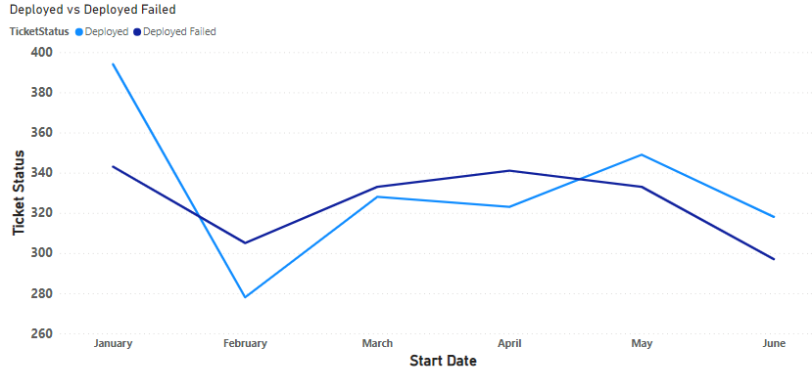
ENSF 607 Ticket Dashboards Chioma Ukaegbu Christian Valdez Redge Santillan
From January 1, 2023 to June 30, 2023

Slide 2
The graph below compares ticket counts for two statuses, "Deployed" and "Deployed Failed," from January to June. Some observations from the following in the graph:
Deployed Tickets (Blue Line): Start high in January, dip in February, peak in March, and show a steady decline thereafter.
Deployed Failed Tickets (Dark Line): Begin moderately in January, peak in February, decrease in March, and then maintain a more gradual decline through June.

Slide 3
While "Deployed" tickets peaked in March and then decreased, "Deployed Failed" tickets had their highest count in February, with a consistent drop-off towards June.

Slide 4
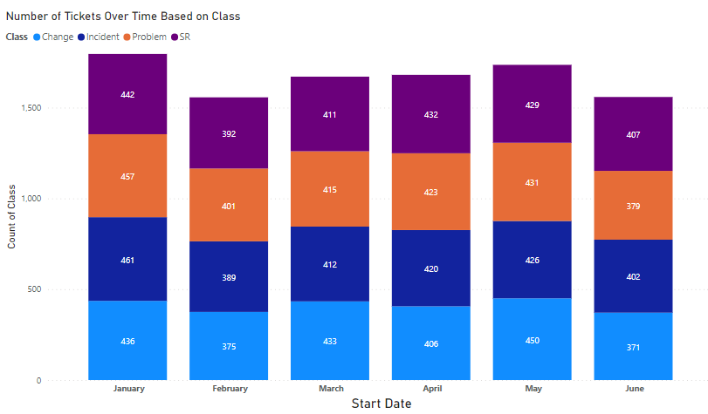
Change Tickets: Peak in January (461), lowest in June (371).
SR Tickets: Highest in April (432), moderate decrease by June (407).
Incident & Problem Tickets: Relatively stable counts, minor fluctuations.
Overall, the ticket distribution is balanced across classes. Change tickets show a declining trend, while SRs peaked in April. Incidents and Problems remain consistent.

Slide 5
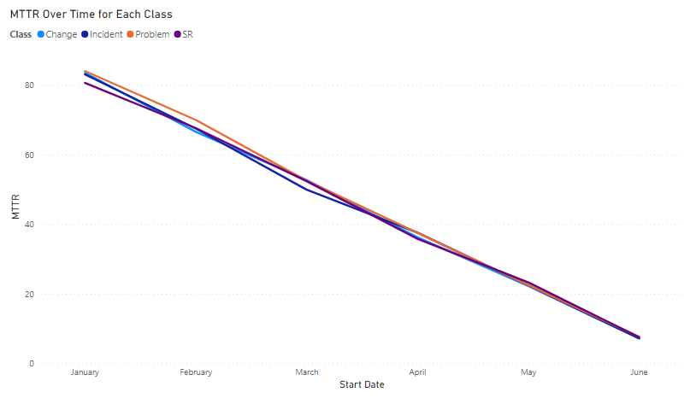
All ticket classes (Change, Incident, Problem, SR) have shown a consistent decline in MTTR from January to June.
The lines for all classes overlap closely, indicating similar resolution times for each class.
Across all ticket classes, the time taken to resolve issues has improved significantly over the six months, indicating more efficient resolution processes or fewer complexities encountered in recent months.

Slide 6
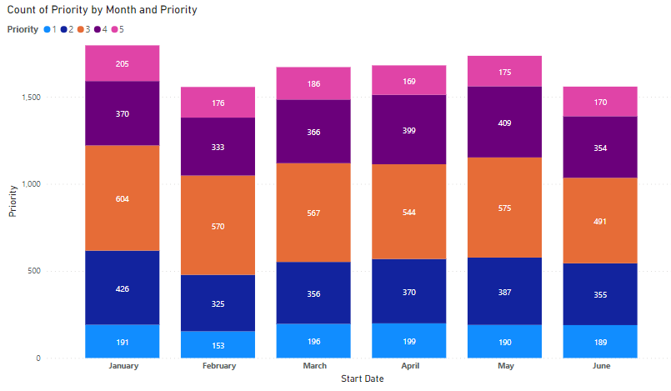
We decided to explore the count of priority by month from January to June.
Overall, the priority 2 tickets have shown a notable rise, peaking in May. Priority 5 tickets saw a consistent decline. The rest maintained a consistent trend across the six months.

Slide 7
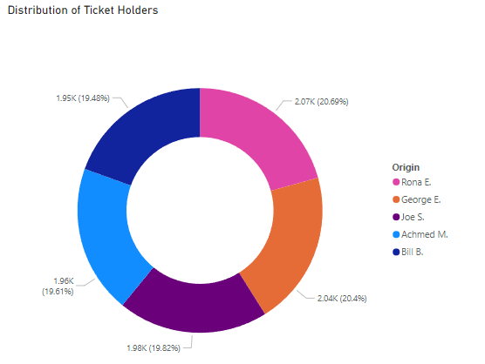
Another exploratory trend we explored was the distribution of ticket holders among the five individuals.
The ticket distribution among the holders is balanced, with each individual managing roughly one-fifth of the total tickets. George E. has the highest count, but the difference is minimal.

